Slide 1
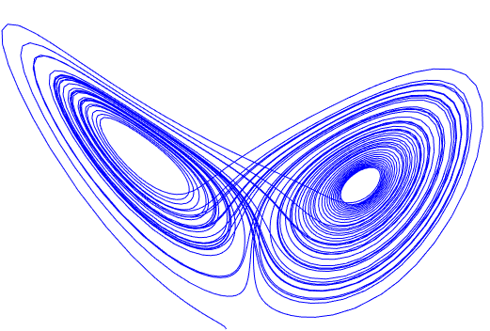
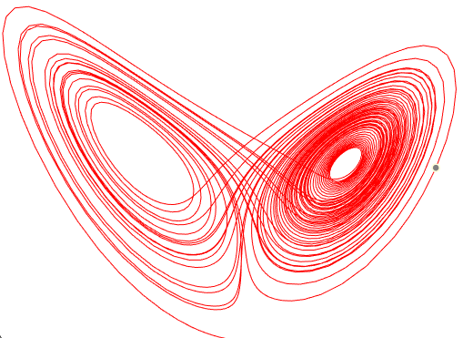
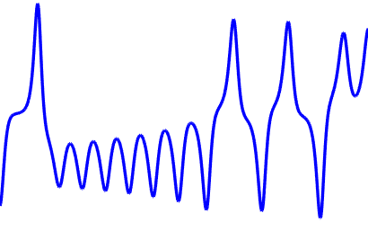
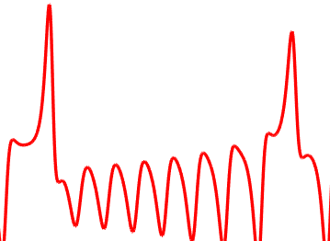
$${\hat{\text{r}}}_{\text{t}}^{\text{x}}\text{=}{\text{W}}_{\text{out}}\left(\text{tanh}\text{(}{\hat{\text{W}}}_{\text{in}}{\text{r}}_{\text{t}}^{\text{y}}\text{+}{\hat{\text{W}}}_{\text{res}}{\hat{\text{r}}}_{\text{t}\text{−}\text{1}}\text{)}\right)$$
$${\text{r}}_{\text{t}}^{\text{x}}$$
cross map Φ_{yx}
$${\text{r}}_{\text{t}}^{\text{y}}$$
Reconstruction
Reconstruction
$${\text{M}}_{\text{x}}$$
$${\text{M}}_{\text{y}}$$
$\text{x}\left(\text{t}\right)$:
$\text{y}\left(\text{t}\right)$:
$${\text{r}}_{\text{t}}^{\text{x}}\text{=}\text{tanh}\left({\text{W}}_{\text{res} }{\text{r}}_{\text{t}\text{−}\text{1}}^{\text{x}}\text{+}{\text{W}}_{\text{in}}\text{x}\left(\text{t}\right)\right)$$
estimates
$${\text{r}}_{\text{t}}^{\text{y}}\text{=}\text{tanh}\left({\text{W}}_{\text{res} }{\text{r}}_{\text{t}\text{−}\text{1}}^{\text{y}}\text{+}{\text{W}}_{\text{in}}\text{y}\left(\text{t}\right)\right)$$
$${\text{r}}_{\text{t}}^{\text{y}}$$
$${\text{r}}_{\text{t}}^{\text{x}}$$
Wres
$${\text{r}}_{\text{t}}^{\text{x}}$$
^
$${\text{r}}_{\text{t}}^{\text{y}}$$
$${\text{x}}_{\text{t}}$$
W_{out}
Wres
^
Wres
$${\text{y}}_{\text{t}}$$
W_{in}
W_{in}
W_{in}
Step1. Embedding
Step2. Estimation
Step1. Embedding
$$\text{Y}$$
causes
^{X}

Slide 2
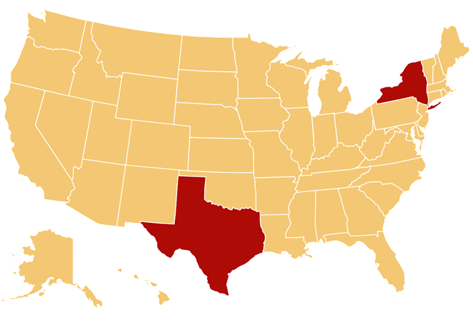
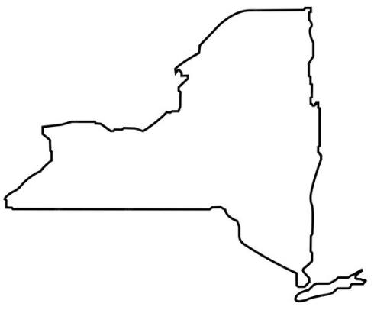
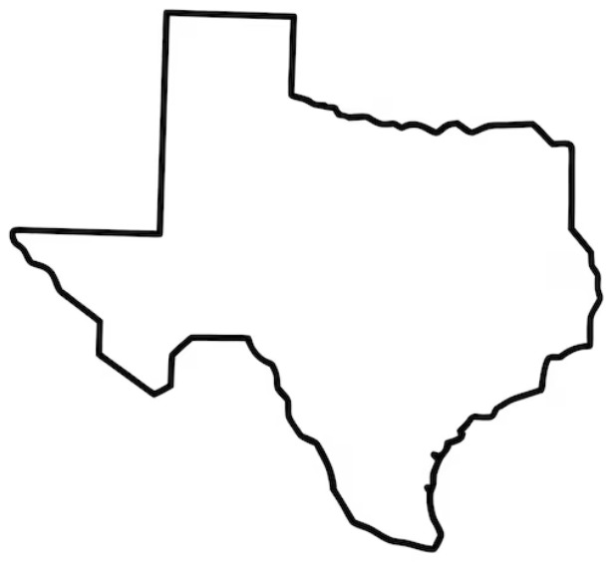
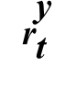
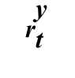
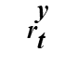
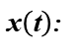
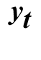
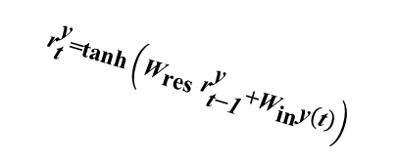
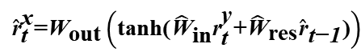
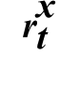
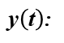
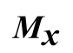
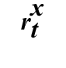
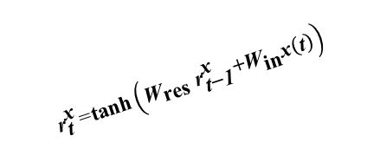
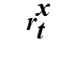
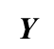
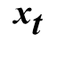
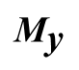
Framework
$${\hat{\text{r}}}_{\text{t}}^{\text{x}}\text{=}{\text{W}}_{\text{out}}\left(\text{tanh}\text{(}{\hat{\text{W}}}_{\text{in}}{\text{r}}_{\text{t}}^{\text{y}}\text{+}{\hat{\text{W}}}_{\text{res}}{\hat{\text{r}}}_{\text{t}\text{−}\text{1}}\text{)}\right)$$
$${\text{r}}_{\text{t}}^{\text{x}}$$
cross map Φ_{yx}
$${\text{r}}_{\text{t}}^{\text{y}}$$
Reconstruction
Reconstruction
$${\text{M}}_{\text{x}}$$
$${\text{M}}_{\text{y}}$$
$\text{x}\left(\text{t}\right)$:
$\text{y}\left(\text{t}\right)$:
$${\text{r}}_{\text{t}}^{\text{x}}\text{=}\text{tanh}\left({\text{W}}_{\text{res} }{\text{r}}_{\text{t}\text{−}\text{1}}^{\text{x}}\text{+}{\text{W}}_{\text{in}}\text{x}\left(\text{t}\right)\right)$$
estimates
$${\text{r}}_{\text{t}}^{\text{y}}\text{=}\text{tanh}\left({\text{W}}_{\text{res} }{\text{r}}_{\text{t}\text{−}\text{1}}^{\text{y}}\text{+}{\text{W}}_{\text{in}}\text{y}\left(\text{t}\right)\right)$$
$${\text{r}}_{\text{t}}^{\text{y}}$$
$${\text{r}}_{\text{t}}^{\text{x}}$$
Wres
$${\text{r}}_{\text{t}}^{\text{x}}$$
^
$${\text{r}}_{\text{t}}^{\text{y}}$$
$${\text{x}}_{\text{t}}$$
W_{out}
Wres
^
Wres
$${\text{y}}_{\text{t}}$$
W_{in}
W_{in}
W_{in}
Step1. Embedding
Step2. Estimation
Step1. Embedding
$$\text{Y}$$
causes
^{X}
Results
RCM
MCM
New York
ALB
LGA
JFK
AMA
ABI
ACT
Texas

Slide 3
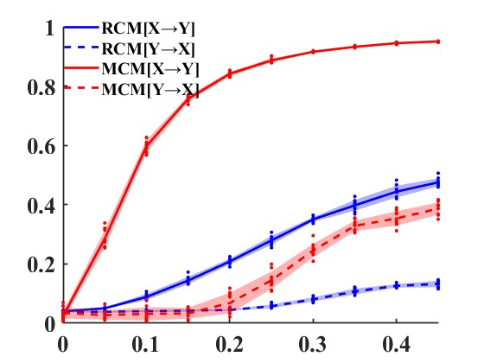
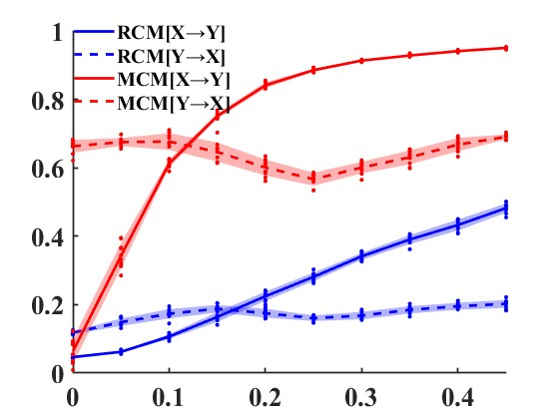
A
$$\text{X}$$
$${\text{β}}_{\text{xy}}$$
$$\text{Y}$$
B
$$\text{X}$$
$${\text{β}}_{\text{xy}}$$
$$\text{Y}$$
$${\text{β}}_{\text{yx}} \text{=} \text{0}$$
$${\text{β}}_{\text{yx}} \text{= }\text{0}\text{.}\text{1}$$
$${\text{β}}_{\text{xy}}$$
$${\text{β}}_{\text{xy}}$$

Slide 4
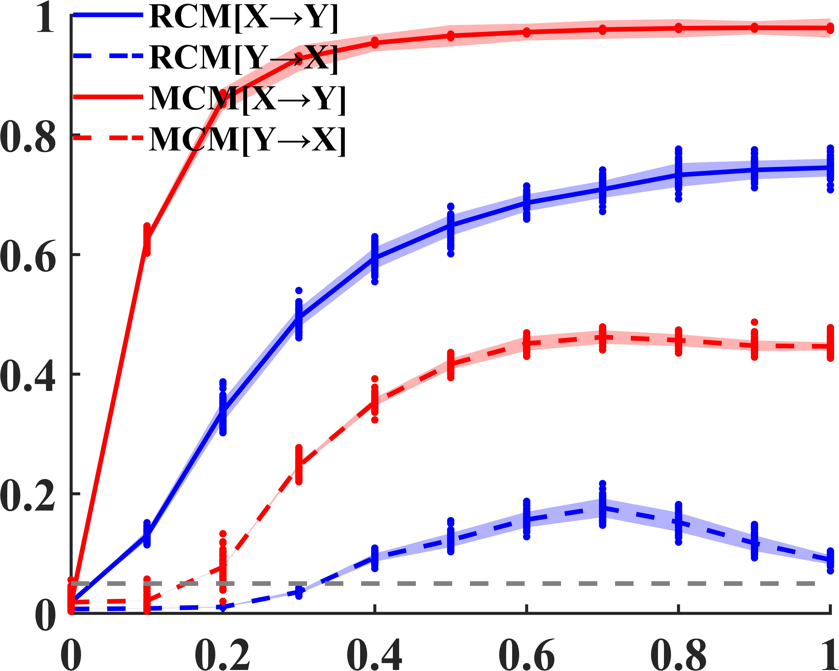
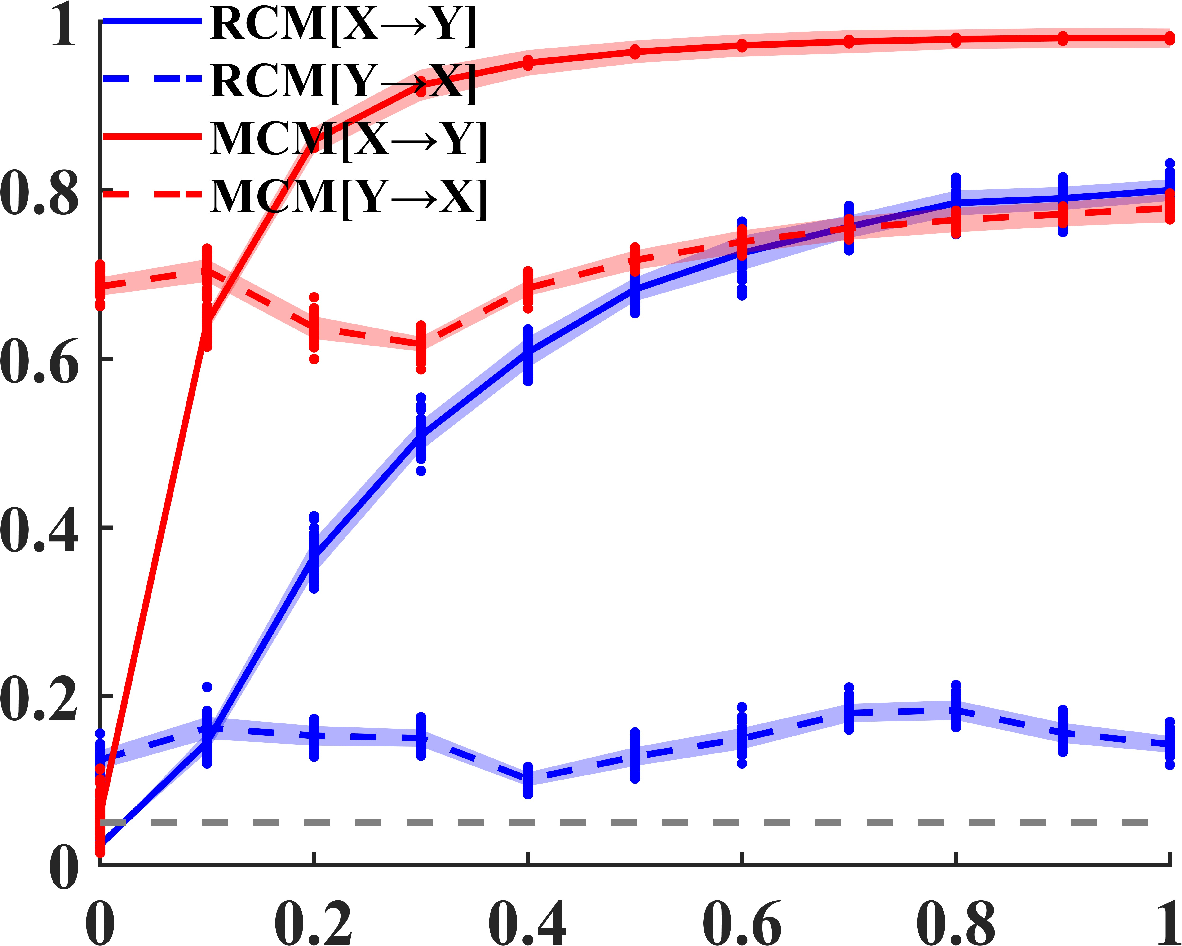
A
$$\text{X}$$
$${\text{β}}_{\text{xy}}$$
$$\text{Y}$$
B
$$\text{X}$$
$${\text{β}}_{\text{xy}}$$
$$\text{Y}$$
$${\text{β}}_{\text{yx}} \text{=} \text{0}$$
$${\text{β}}_{\text{yx}} \text{= }\text{0}\text{.}\text{1}$$
$${\text{β}}_{\text{xy}}$$
$${\text{β}}_{\text{xy}}$$

Slide 5
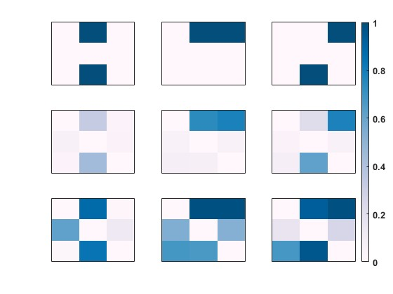
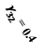
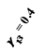
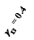
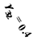
Fan-in
Fan-out
Cascade
$$\text{Y}\text{3}$$
$${\text{γ}}_{\text{32}} \text{= 0.4}$$
$${\text{γ}}_{\text{13}} \text{= 0.4}$$
$$\text{Y}\text{3}$$
$${\text{γ}}_{\text{13} }\text{= 0.4}$$
$$\text{Y}\text{3}$$
$${\text{γ}}_{\text{32}} \text{= 0.4}$$
$$\text{Y}\text{1}$$
$${\text{γ}}_{\text{12}} \text{= 0.4}$$
$$\text{Y}\text{2}$$
$$\text{Y}\text{1}$$
$${\text{γ}}_{\text{12} }\text{= 0.4}$$
$$\text{Y}\text{2}$$
$$\text{Y}\text{1}$$
$$\text{Y}\text{2}$$
Ground
Truth
$$\text{1}$$
$$\text{0}$$
$$\text{1}$$
$$\text{1}$$
$$\text{0}$$
$$\text{1}$$
$$\text{0}$$
$$\text{0}$$
$$\text{0}$$
$$\text{0}$$
$$\text{0}$$
$$\text{0}$$
$$\text{0}$$
$$\text{1}$$
$$\text{0}$$
$$\text{0}$$
$$\text{0}$$
$$\text{1}$$
RCM
$$\text{0.33}$$
$$\text{0.03}$$
$$\text{0.74}$$
$$\text{0.78}$$
$$\text{0.21}$$
$$\text{0.78}$$
$$\text{0.06}$$
$$\text{0.04}$$
$$\text{0.06}$$
$\text{0}$.06
$$\text{0.04}$$
$$\text{0.05}$$
$$\text{0.04}$$
$$\text{0.44}$$
$$\text{0.08}$$
$$\text{0.08}$$
$\text{0}$.08
$$\text{0.62}$$
$$\text{0.88}$$
$$\text{0.02}$$
$$\text{0.98}$$
$$0.98$$
$$\text{0.93}$$
$$\text{0.98}$$
MCM
$$\text{0.98}$$
$$\text{0.62}$$
$$\text{0.13}$$
$$\text{0.54}$$
$$\text{0.53}$$
$$\text{0.16}$$
$$\text{0.25}$$
$$\text{0.02}$$
$$\text{0.84}$$
$$\text{0.68}$$
$$\text{0.67}$$
$$\text{0.67}$$
$$\text{0.96}$$

Slide 6
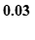
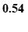
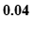
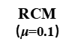
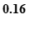
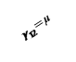
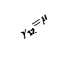
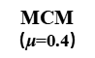
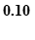
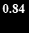
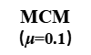
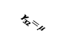
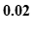
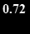
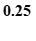
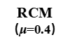
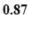
Ground
Truth
RCM
$\text{（}\text{μ}$=0.1）
RCM
$\text{（}\text{μ}$=0.4）
MCM
$\text{（}\text{μ}$=0.1）
MCM
$\text{（}\text{μ}$=0.4）
$$\text{Y}\text{1}$$
$$0$$
$$\text{1}$$
0.10
0.49
$$\text{0.10}$$
$$\text{0.72}$$
0.89
0.96
$$\text{0.93}$$
$$\text{0.98}$$
Cascade
$${\text{γ}}_{\text{13}}\text{=} \text{μ}$$
$$\text{Y}\text{2}$$
$$0$$
$$0$$
0.09
0.10
$$\text{0.02}$$
$$\text{0.03}$$
0.87
0.90
$$\text{0.16}$$
$$\text{0.25}$$
$${\text{γ}}_{\text{32}}\text{=} \text{μ}$$
$$\text{Y}\text{3}$$
$$0$$
$$\text{1}$$
0.21
0.43
$\text{0}$.04
$$\text{0.58}$$
0.93
0.96
$$\text{0.67}$$
$$\text{0.96}$$
$$\text{Y}\text{1}$$
$${\text{γ}}_{\text{12}}\text{=} \text{μ}$$
$$\text{1}$$
$$\text{1}$$
0.44
0.45
$$\text{0.71}$$
$$\text{0.74}$$
0.95
0.96
$$\text{0.98}$$
$$\text{0.98}$$
Fan-out
$${\text{γ}}_{\text{13}}\text{=} \text{μ}$$
$$\text{Y}\text{2}$$
$$0$$
$$0$$
0.09
0.08
$$\text{0.03}$$
$\text{0}$.03
$$\text{0.88}$$
$$\text{0.87}$$
$$\text{0.54}$$
$$\text{0.53}$$
$$\text{Y}\text{3}$$
$$0$$
$$0$$
0.16
0.14
$$\text{0.05}$$
$$\text{0.04}$$
0.94
0.93
$$\text{0.68}$$
$$\text{0.67}$$
$$\text{Y}\text{1}$$
Fan-in
$${\text{γ}}_{\text{12}}\text{=} \text{μ}$$
$$\text{1}$$
$$0$$
0.18
0.02
0.27
0.02
0.82
0.03
$$\text{0.88}$$
$$\text{0.02}$$
$$\text{Y}\text{2}$$
$$0$$
$$0$$
0.10
0.02
$$\text{0.04}$$
$$\text{0.03}$$
0.69
$$\text{0.02}$$
$$\text{0.62}$$
$$\text{0.13}$$
$${\text{γ}}_{\text{32}}\text{= }\text{μ}$$
$$\text{Y}\text{3}$$
$$0$$
$$\text{1}$$
0.02
0.15
$$\text{0.02}$$
$$\text{0.40}$$
$$\text{0.03}$$
0.74
$$\text{0.02}$$
$$\text{0.84}$$

Slide 7
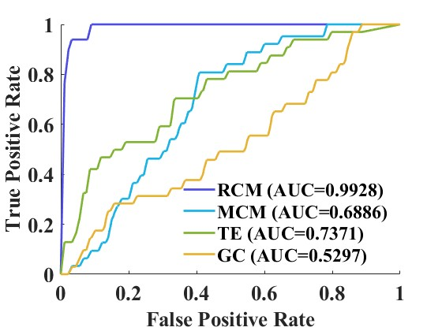




A
B
$$\text{μ} \text{= }\text{0}\text{.}\text{5}\text{, }\text{ρ}\text{ = }\text{0}\text{.}\text{1}$$
$$\text{μ}\text{ = }\text{1}\text{, }\text{ρ} \text{= }\text{0}\text{.}\text{1}$$
$$\text{μ} \text{= }\text{0}\text{.}\text{5}\text{, } \text{ρ}\text{ = }\text{0}\text{.}\text{3}$$
$$\text{μ}\text{ = }\text{1}\text{, } \text{ρ}\text{ = }\text{0}\text{.}\text{3}$$
With Causation
Without Causation

Slide 8




A
B
$$μ=0.1, ρ=0.1$$
$$μ=0.5, ρ=0.1$$
$$μ=0.1, ρ=0.3$$
$$μ=0.5, ρ=0.3$$
With Causation
Without Causation

Slide 9




A
B
Effect
Nino1+2
Nino 3.4
Nino3
Cause
Nino 4
Nino 3
Nino3.4
Nino 1+2
Nino4
C
D
Nino1+2
Nino3
Nino3.4
Nino4
New York
Effect
ALB
ABI
LGA
ACT
AMA
JFK
Cause
AMA
ALB
ABI
ACT
JFK
Texas
LGA
ABI
ACT
AMA
ALB
JFK
LGA

Slide 10








A
RCM
MCM
B
RCM
MCM
New York
ALB
Nino 3.4
LGA
JFK
Nino 4
Nino 3
AMA
Nino 1+2
ACT
ABI
Texas
C
D
RCM
RCM
Nino1+2
RCM [with causation]
ABI
RCM [with causation]
RCM [without causation]
ACT
RCM [without causation]
Nino3
AMA
Cause
Cause
Nino3.4
ALB
0.2129
JFK
0.3124
Nino4
LGA
Nino1+2
Nino3
Nino3.4
Nino4
ABI
ACT
AMA
ALB
JFK
LGA
Effect
RCM index
Effect
RCM index
MCM
MCM
Nino1+2
MCM [with causation]
ABI
MCM [with causation]
MCM [without causation]
ACT
MCM [without causation]
Nino3
AMA
Cause
Cause
Nino3.4
ALB
0.6727
JFK
0.8515
Nino4
LGA
Nino1+2
Nino3
Nino3.4
Nino4
ABI
ACT
AMA
ALB
JFK
LGA
Effect
MCM index
Effect
MCM index

Slide 11





A
B
$$μ\text{ = }\text{0}\text{.}\text{1，}σ_{ex}\text{=}\text{0}\text{，}\text{L}\text{=}\text{10000}$$
C
$$μ\text{ = }\text{0}\text{.}\text{1，}σ_{ex}\text{=}\text{0}\text{，}\text{L}\text{=}\text{10000}$$
2
1
3
Coupled
Lorenz network
(ring)
5
4
D
$$σ_{in}(innoise)$$
E
$$σ_{ex}(exnoise)$$
Effect
$$\left[\begin{matrix}0 & 1 & 0 & 0 & 0 \\ 0 & 0 & 1 & 0 & 0 \\ 0 & 0 & 0 & 1 & 0 \\ 0 & 0 & 0 & 0 & 1 \\ 1 & 0 & 0 & 0 & 0\end{matrix}\right]$$
Cause
$${×10}^{3}$$
L (trainning length)
m (the number of neurons)

Slide 12














A
B
$$μ\text{ = }\text{0}\text{.}\text{1，}σ^{ex}\text{=}\text{0}\text{，}\text{m}\text{=}\text{200}\text{, }\text{L}\text{=}\text{10000}$$
C
$$μ\text{ = }\text{0.1}\text{，}σ^{ex}\text{=}\text{0}\text{，}\text{m}\text{=}\text{200}\text{，}\text{L}\text{=}\text{10000}$$
2
1
3
RCM Index
Coupled
Lorenz network
(ring)
MCM Index
5
4
$$σ^{in}(innoise)$$
$$σ^{in}(innoise)$$
D
$$μ\text{ = }\text{0.1}\text{，}σ^{in}\text{=}\text{0}\text{，}\text{m}\text{=}\text{200}\text{, }\text{L}\text{=}\text{10000}$$
E
$$μ \text{= }\text{0.1}\text{，}σ^{in}\text{=}\text{0}\text{，}\text{m}\text{=}\text{200}\text{, }\text{L}\text{=}\text{10000}$$
Effect
$$\left[\begin{matrix}0 & 1 & 0 & 0 & 0 \\ 0 & 0 & 1 & 0 & 0 \\ 0 & 0 & 0 & 1 & 0 \\ 0 & 0 & 0 & 0 & 1 \\ 1 & 0 & 0 & 0 & 0\end{matrix}\right]$$
Cause
RCM Index
MCM Index
F
$$μ\text{ = }\text{0}\text{.}\text{1，}σ^{ex}\text{=}\text{0}\text{，}σ^{in}\text{=}\text{0}\text{，}\text{m}\text{=}\text{200}$$
G
$$σ^{ex}(exnoise)$$
$$σ^{ex}(exnoise)$$
$$μ\text{ = }\text{0}\text{.}\text{1，}σ^{ex}\text{=}\text{0}\text{，}σ^{in}\text{=}\text{0}\text{，}\text{m}\text{=}\text{200}$$
H
$$μ\text{ = }\text{0}\text{.}\text{1，}σ^{ex}\text{=}\text{0}\text{，}σ^{in}\text{=}\text{0}\text{，}\text{m}\text{=}\text{200}$$
RCM Index
MCM Index
Tmie (s)
×10³
×10³
×10³
I
L (data length)
J
L (data length)
K
L (data length)
$$μ\text{ = }\text{0}\text{.}\text{1，}σ^{ex}\text{=}\text{0}\text{，}σ^{in}\text{=}\text{0}\text{，}\text{L}\text{=}\text{10000}$$
$$μ\text{ = }\text{0}\text{.}\text{1，}σ^{ex}\text{=}\text{0}\text{，}σ^{in}\text{=}\text{0}\text{，}\text{L}\text{=}\text{10000, }\text{m}\text{E}\text{=200}$$
$$μ\text{ = }\text{0}\text{.}\text{1，}σ^{ex}\text{=}\text{0}\text{，}σ^{in}\text{=}\text{0}\text{，}\text{L}\text{=}\text{10000, }\text{m}\text{C}\text{=200}$$
RCM Index
RCM Index
RCM Index
m
m_{C}
m_{E}

Slide 13


7
C
8
6
RCM
A
1
5
8
7
6
2
4
Coupled
Henon network
3
1
5
D
E
2
4
8
7
6
3
MCM
1
5
2
3
4

